Slide 1
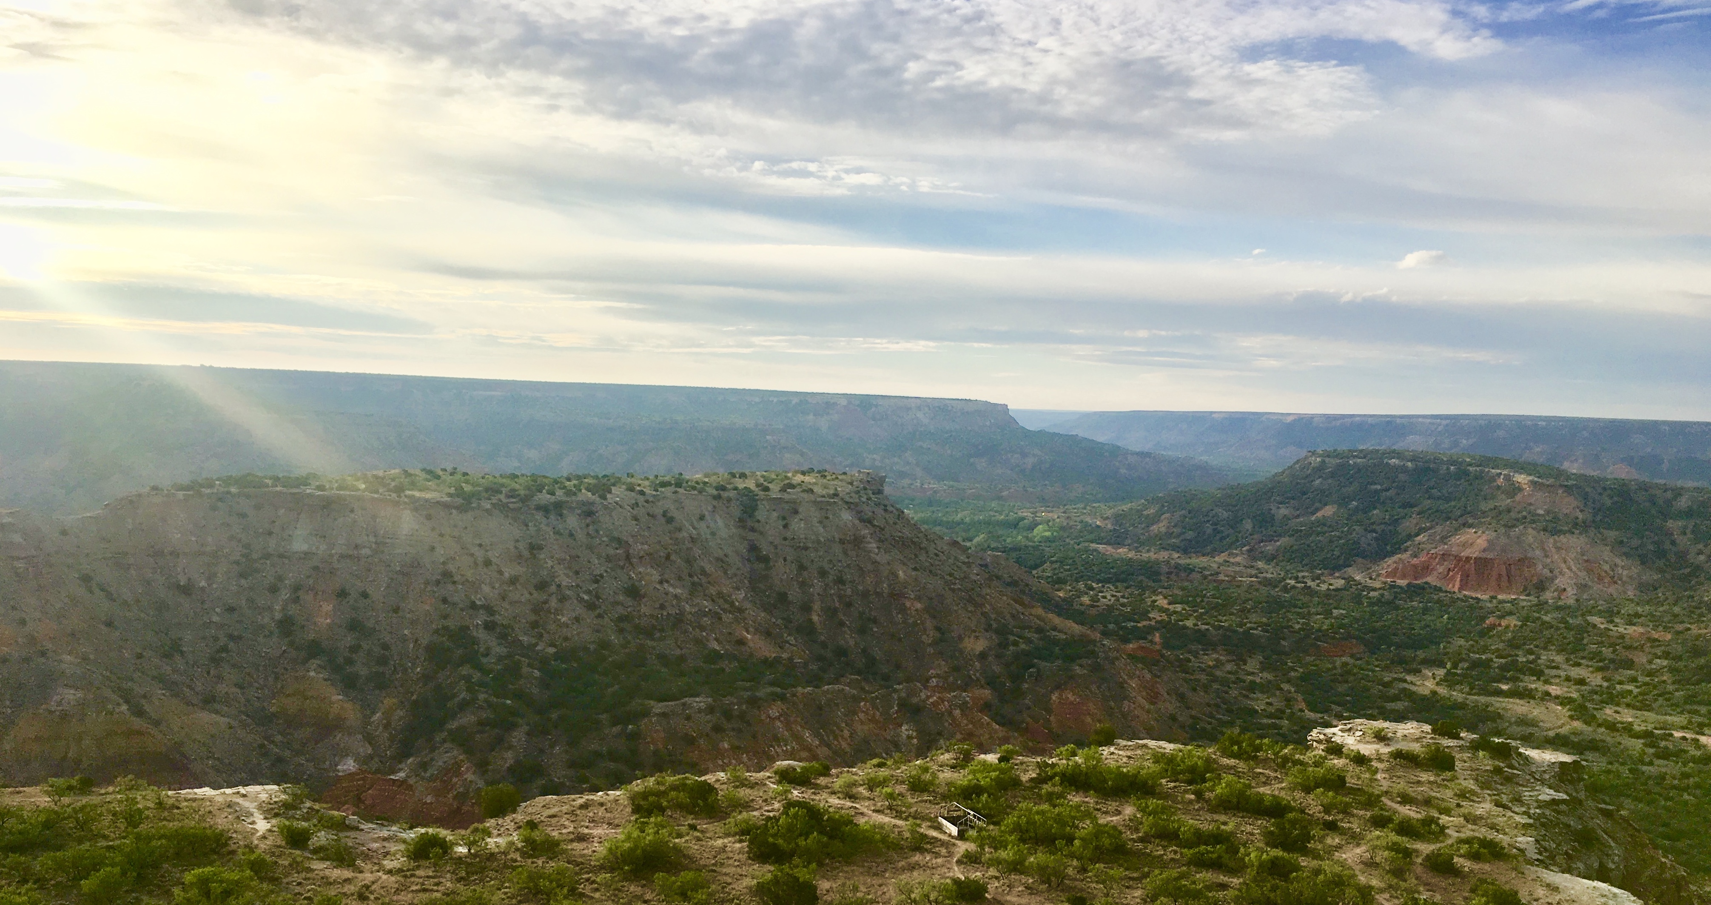
Drivers of plant nutrient acquisition and allocation strategies and their influence on plant responses to environmental change
Evan A. Perkowski
Dissertation Defense
March 07, 2023, 1pm CT ESB1 Room 120
Zoom link:
https://texastech.zoom.us/j/93966902565?pwd=YVZEc0F6dytNY3B1SlNjM1lDVW1VUT09

Slide 2
General Introduction

Slide 3
Adapted from Fig 5.12 in IPCC (2021)

Slide 4
Photosynthesis = largest carbon flux between the atmosphere and land surface
Adapted from Fig 5.12 in IPCC (2021)

Slide 5
Photosynthesis = largest carbon flux between the atmosphere and land surface
Terrestrial biosphere models must accurately simulate photosynthetic processes to predict ecosystem responses to environmental change
Adapted from Fig 5.12 in IPCC (2021)

Slide 6
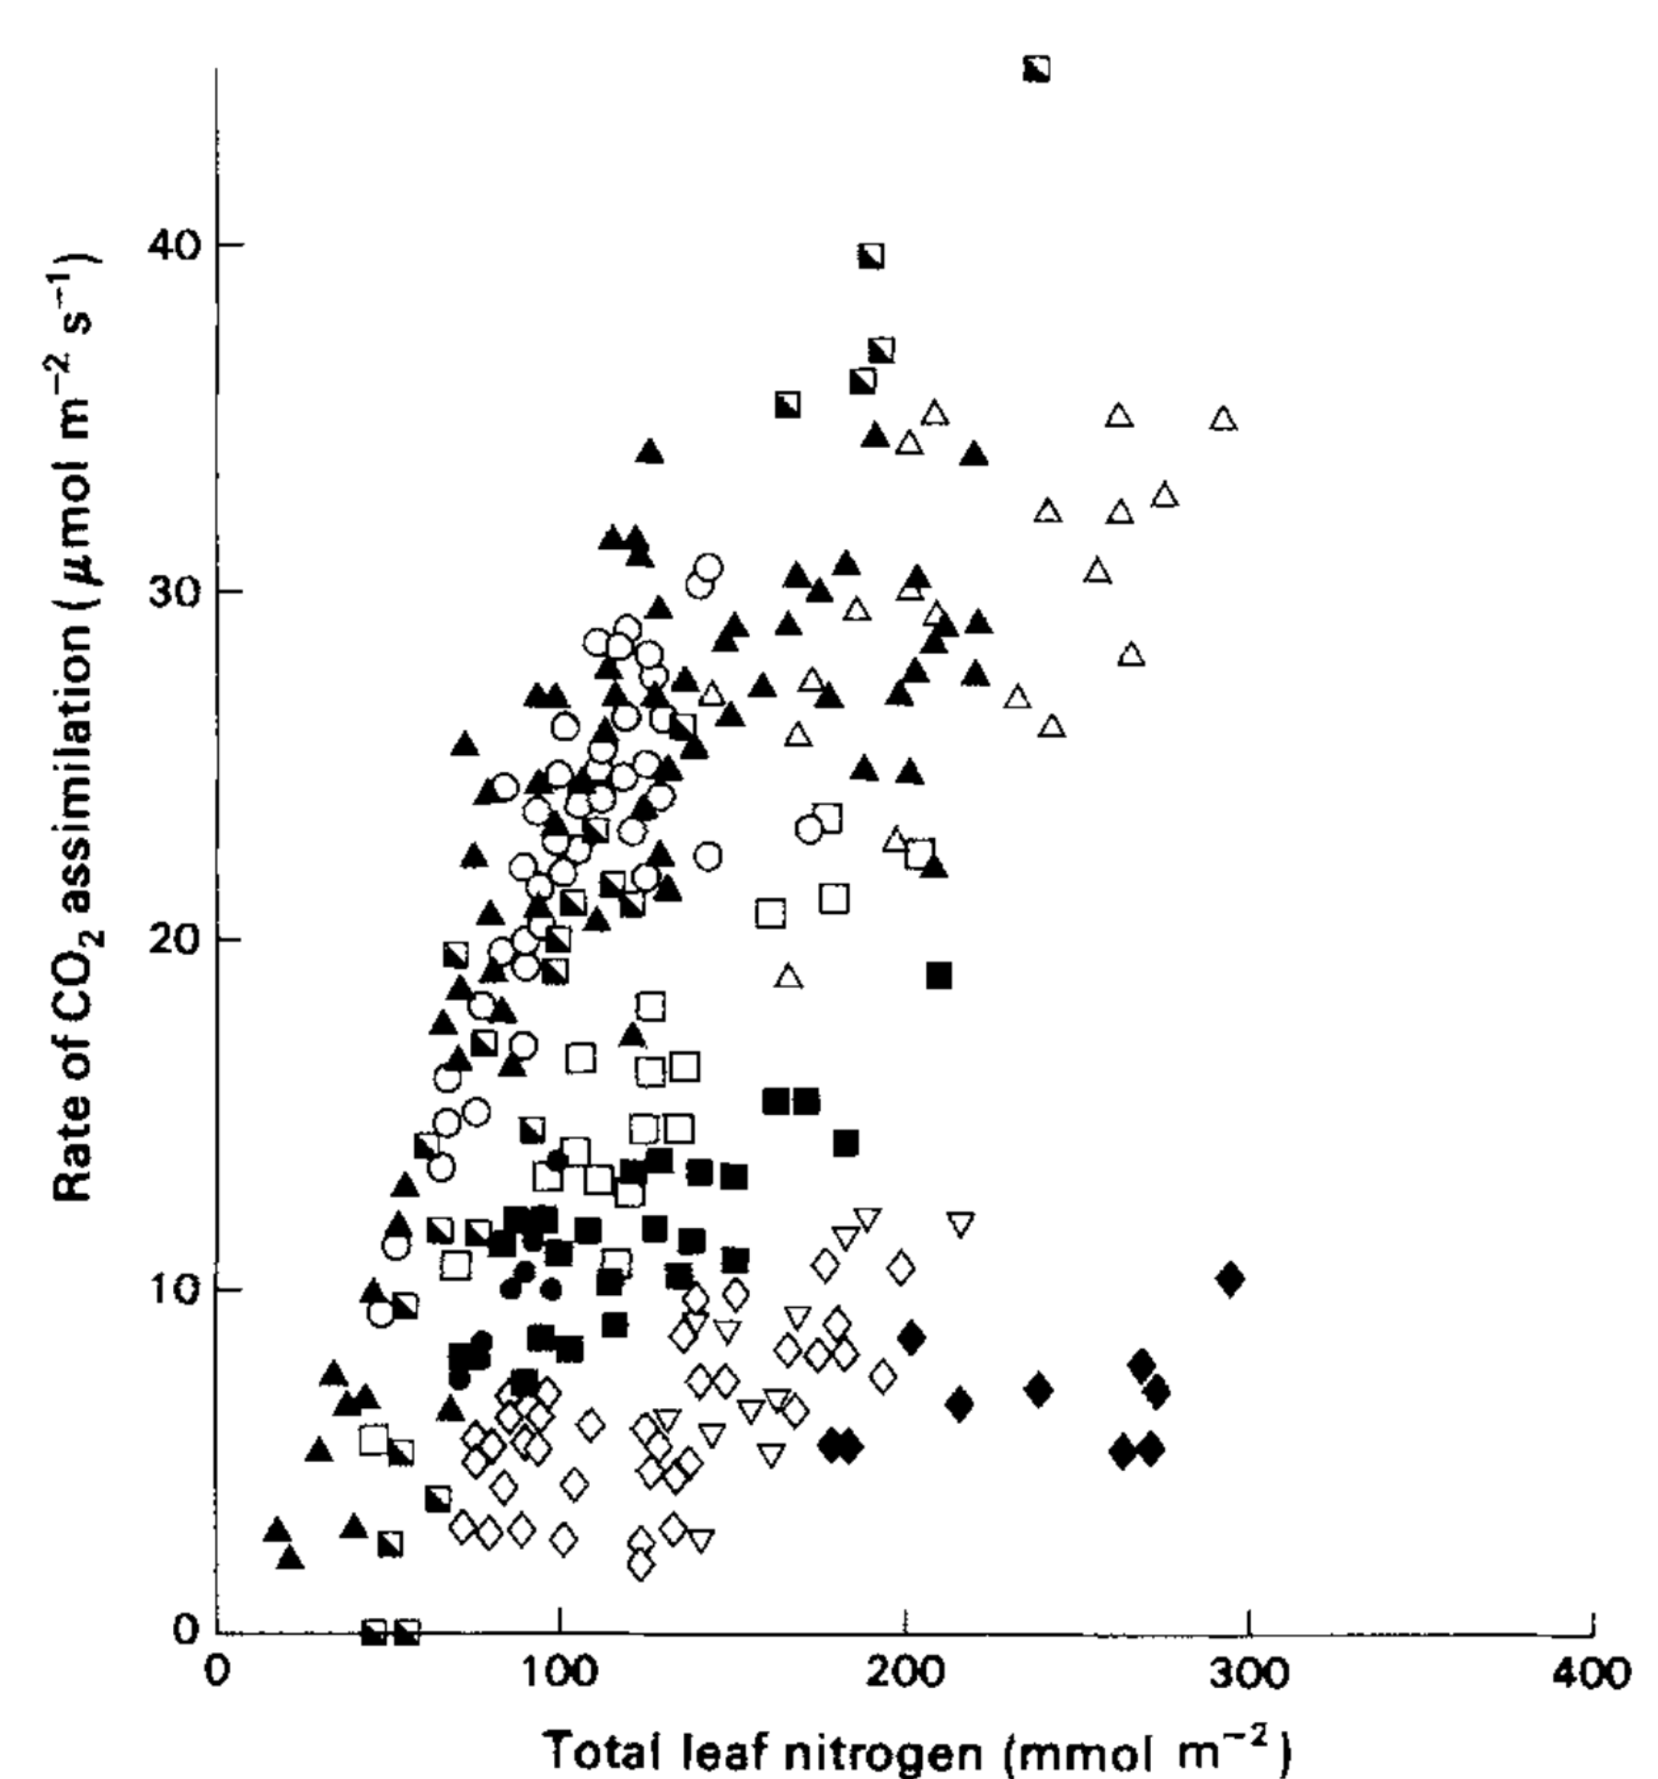
Terrestrial biosphere models simulate photosynthesis through linear relationships between leaf nitrogen content and photosynthetic capacity…
Evans (1989) Oecologia

Slide 7
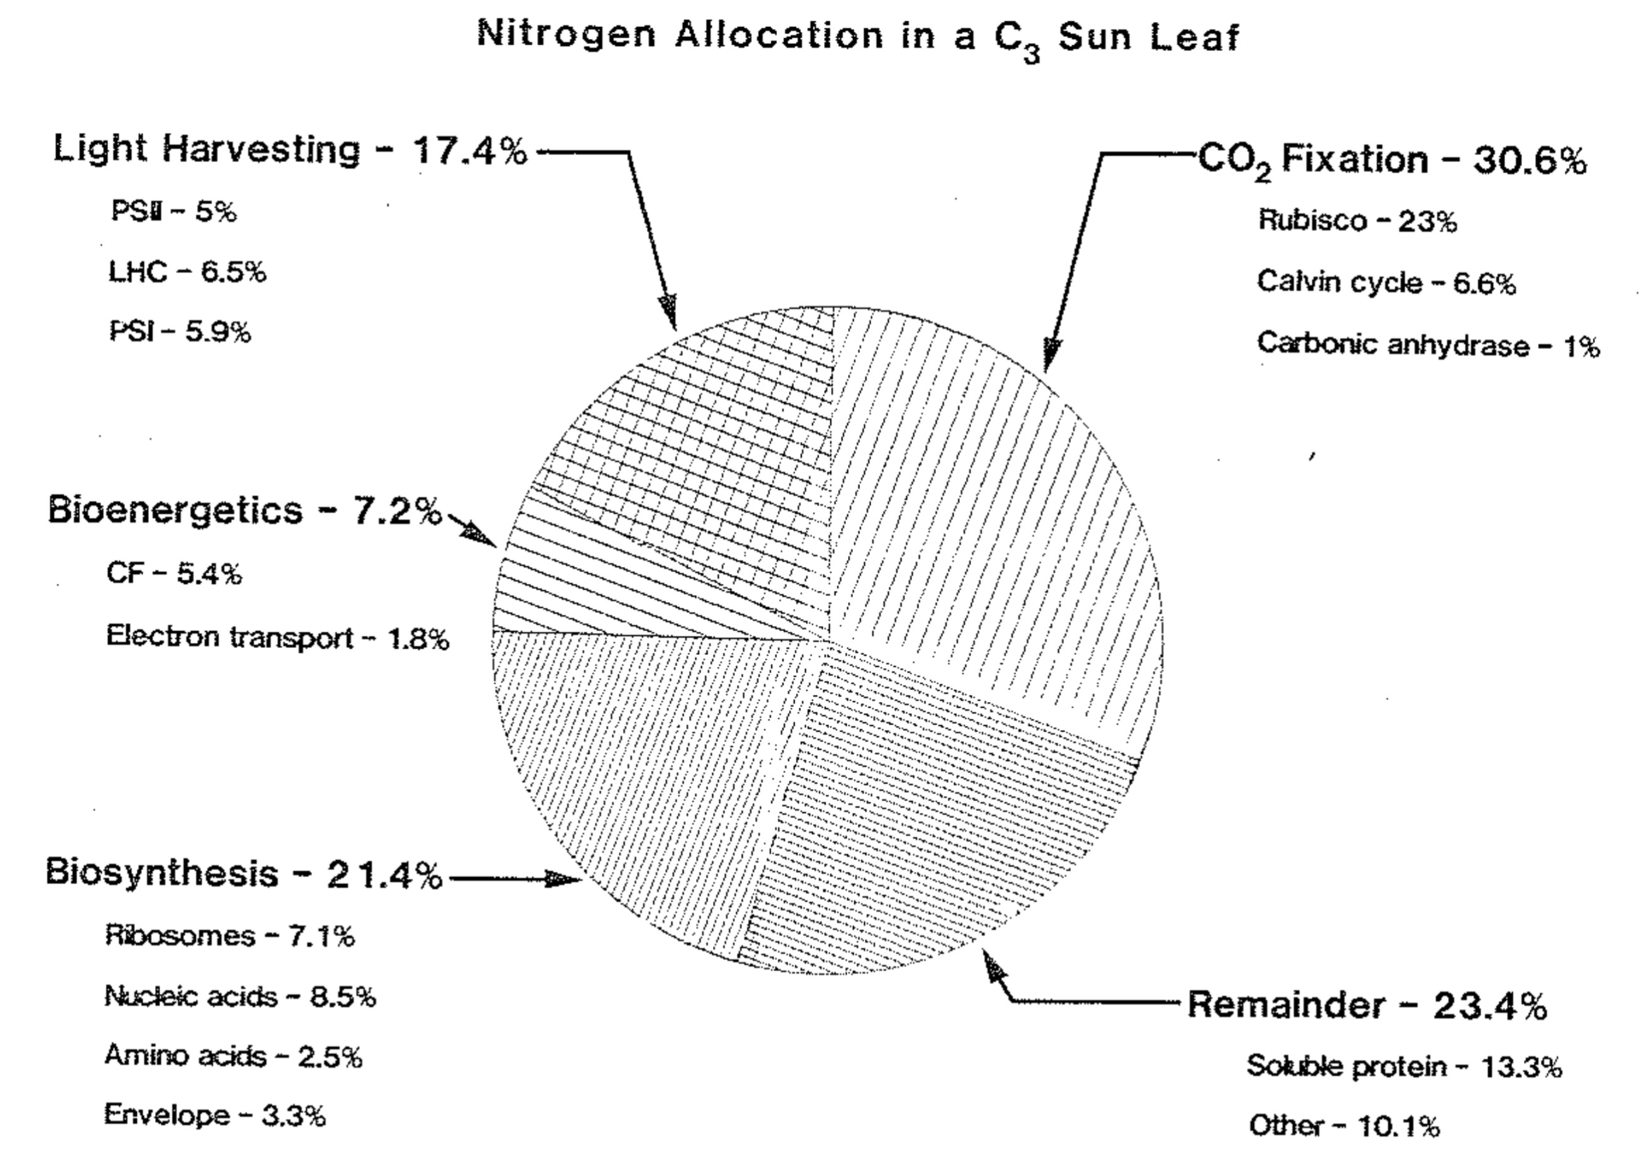
… following that high fractions of leaf nitrogen content are allocated to photosynthetic tissues
Evans (1989) Oecologia
Evans & Seemann (1989) Photosynthesis

Slide 8
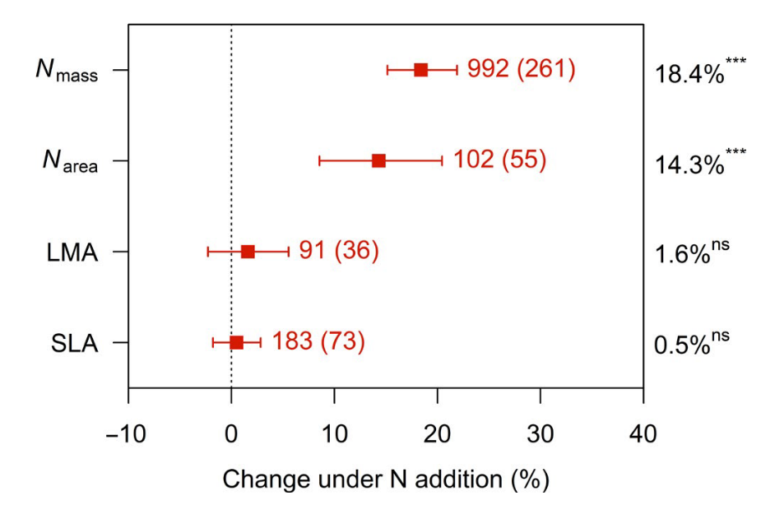
Soil nitrogen generally increases leaf nitrogen…
Liang et al. (2020) Global Change Biology

Slide 9
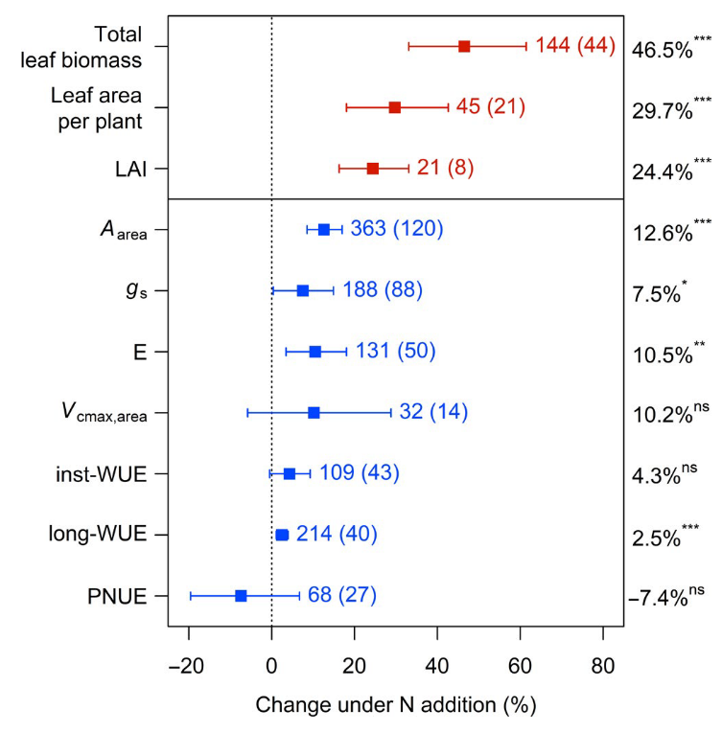
… which often corresponds with increased photosynthesis
Liang et al. (2020) Global Change Biology

Slide 10
… which corresponds with increased photosynthesis
Liang et al. (2020) Global Change Biology

Slide 11
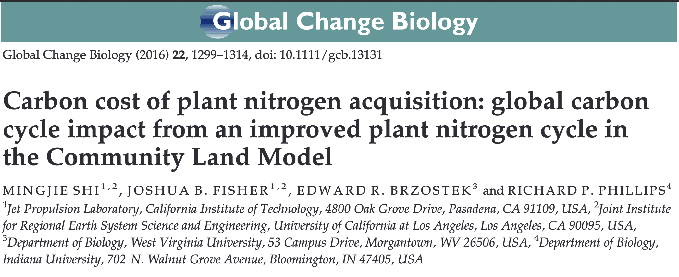
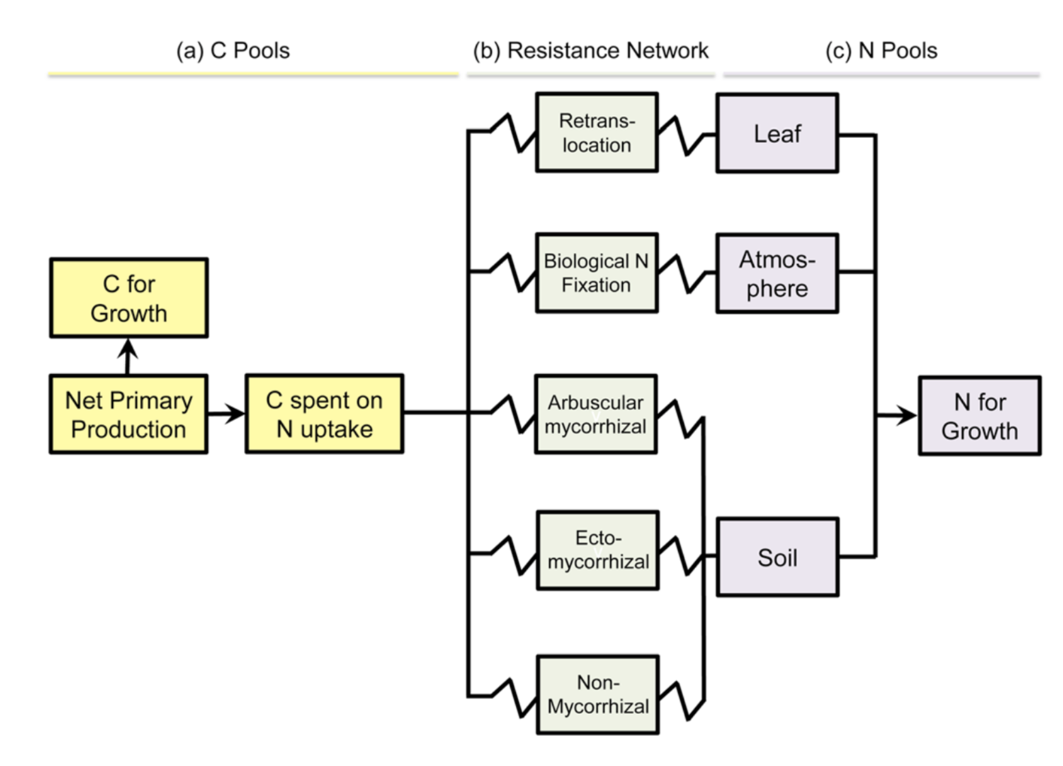
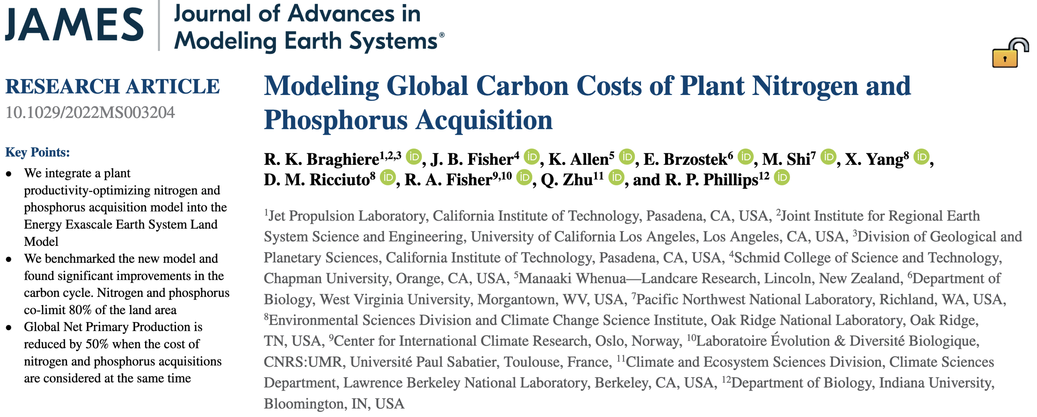
Models are beginning to incorporate coupled carbon and nitrogen cycles...
Brzostek et al. (2014)

Slide 12
… which means that leaf photosynthesis can be indirectly predicted through changes in soil nitrogen availability
Soil N
Leaf N
Photo-synthesis
Rogers (2014) Photosynthesis Research; Rogers et al. (2017) New Phytologist

Slide 13
This framework seemingly supports empirical data
Liang et al. (2020) Global Change Biology

Slide 14
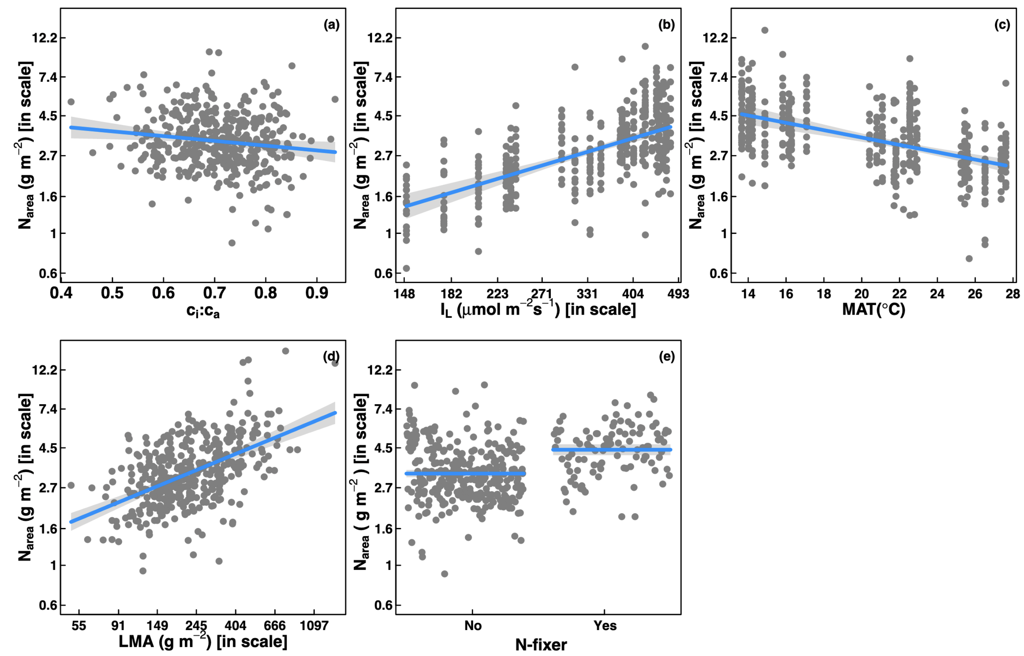
However, leaf nitrogen can be predicted independent of soil nitrogen…
Dong et al. (2017) Biogeosciences
Notes:
calls the use of these relationships in terrestrial biosphere models into question

Slide 15
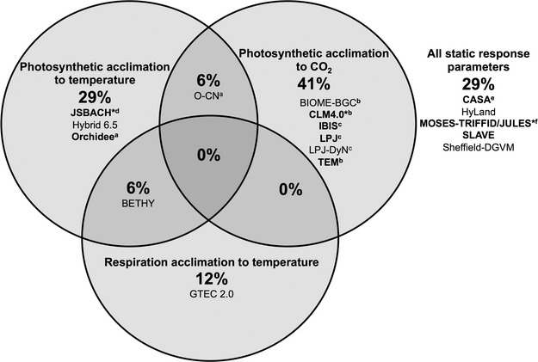
… and most terrestrial biosphere models do not invoke plant acclimation responses to changing environments
Smith & Dukes (2013) Global Change Biology

Slide 16
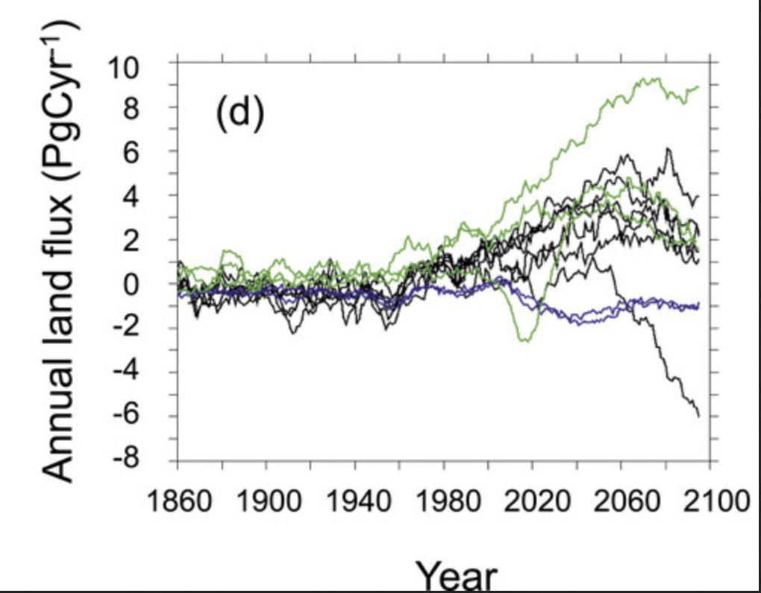
Therefore, large divergence in model simulations under future environments…
… may be the result of
uncertainty in the response of
photosynthetic processes to
future environmental conditions
Friedlingstein et al. (2014) Journal of Climate

Slide 17
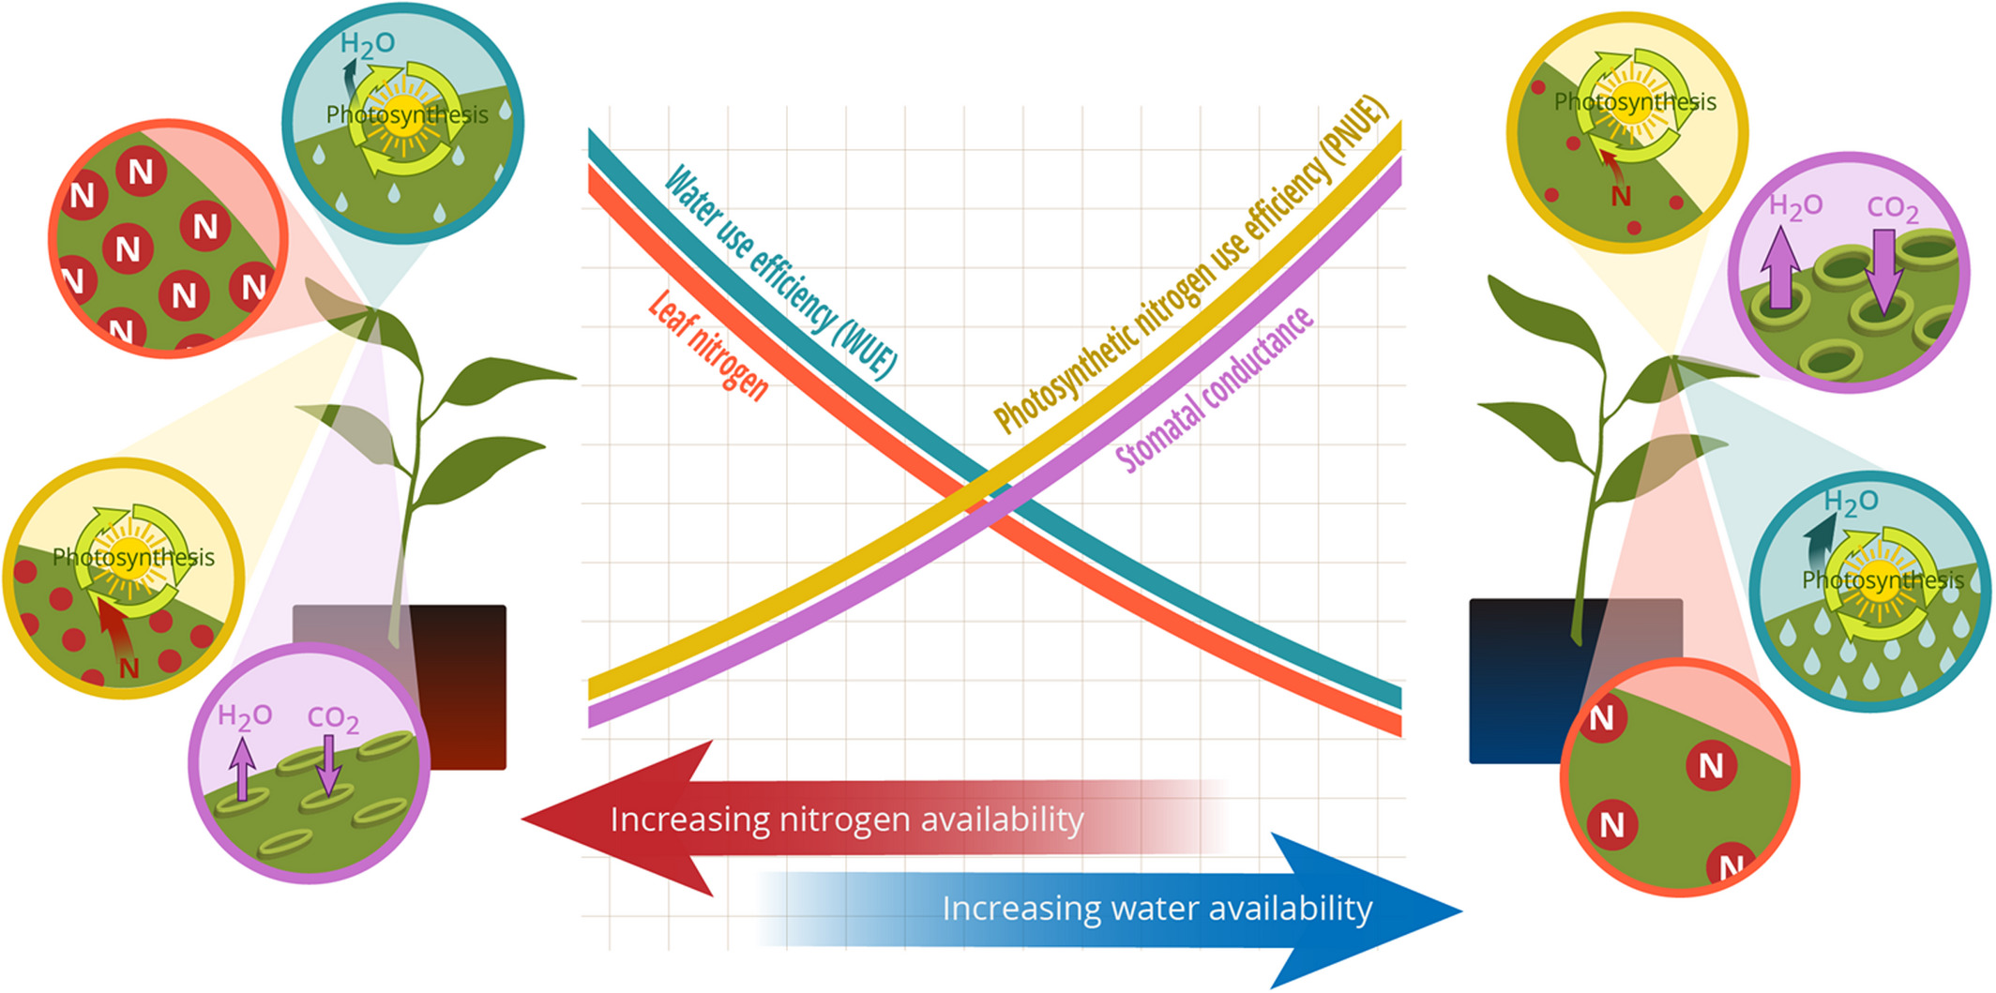
Photosynthetic least-cost theory: leaves acclimate to changing climatic and edaphic environments via summed cost of resource use (nitrogen and water)
Bialic-Murphy et al. (2021) Ecology Letters

Slide 18
Photosynthetic least-cost theory: leaves acclimate to changing climatic and edaphic environments via summed cost of resource use (nitrogen and water)
Bialic-Murphy et al. (2021) Ecology Letters

Slide 19
Photosynthetic least-cost theory: leaves acclimate to changing climatic and edaphic environments via summed cost of resource use (nitrogen and water)
Bialic-Murphy et al. (2021) Ecology Letters

Slide 20
While promising, empirical tests of the theory are sparse

Slide 21
Dissertation Questions/Objectives
Vignette 1: How do costs of nitrogen acquisition vary across environments?

Slide 22
Dissertation Questions/Objectives
Vignette 1: How do costs of nitrogen acquisition vary across environments?
Vignette 2: To what extent do edaphic and climatic factors modify nitrogen-water use tradeoffs and leaf nitrogen-photosynthesis relationships?

Slide 23
Dissertation Questions/Objectives
Vignette 1: How do costs of nitrogen acquisition vary across environments?
Vignette 2: To what extent do edaphic and climatic factors modify nitrogen-water use tradeoffs and leaf nitrogen-photosynthesis relationships?
Vignette 3: How does soil nitrogen availability modify plant acclimation responses to elevated CO₂?

Slide 24
Experiment #1: Light-by-nitrogen greenhouse manipulation experiment
Vignette 1
Perkowski et al. (2021) Journal of Experimental Botany

Slide 25


Experimental Setup
Vignette 1
G. hirsutum
Light availability treatments
Soil fertilization treatments
Species
0% shade cover
0 ppm N
30% shade cover
70 ppm N
Gossypium hirsutum
50% shade cover
210 ppm N
Glycine max
G. max
80% shade cover
630 ppm N
Pictographs from biorender.com
Perkowski et al. (2021) Journal of Experimental Botany

Slide 26
Measurements
Vignette 1
Root carbon biomass
Carbon cost to acquire nitrogen
=
Whole-plant nitrogen biomass
Perkowski et al. (2021) Journal of Experimental Botany
Notes:
We quantified carbon costs to acquire nitrogen as a function of root carbon biomass and whole-plant nitrogen biomass.
There are several limitations associated with this metric that I unfortunately do not have time to get into here. If you want more information about this metric, I’ve linked a QR code at the end of this talk to our recently accepted manuscript on this work.

Slide 27
Hypotheses
Vignette 1
G. max carbon costs to acquire nitrogen
Light availability
G. hirsutum carbon costs to acquire nitrogen
Nitrogen fertilization
Positive effect
Negative effect
Notes:
We used this experiment to test the following hypotheses
Light availability would impact carbon costs to acquire nitrogen similarly in both species.
This would likely be indexed by a larger increase in root carbon biomass than whole plant nitrogen biomass due to the short temporal scale of this study
However, we expected that nitrogen availability would impact carbon costs to acquire nitrogen differently between species
We expected that carbon costs to acquire nitrogen would decrease with increasing soil nitrogen fertilization in G. hirsutum due to an increase in per-root nitrogen uptake
However, we expected that these carbon costs would not change with soil nitrogen fertilization in G. max. This is because G. max would acquire most of its nitrogen from nitrogen fixation and independent of soil nitrogen fertilization

Slide 28
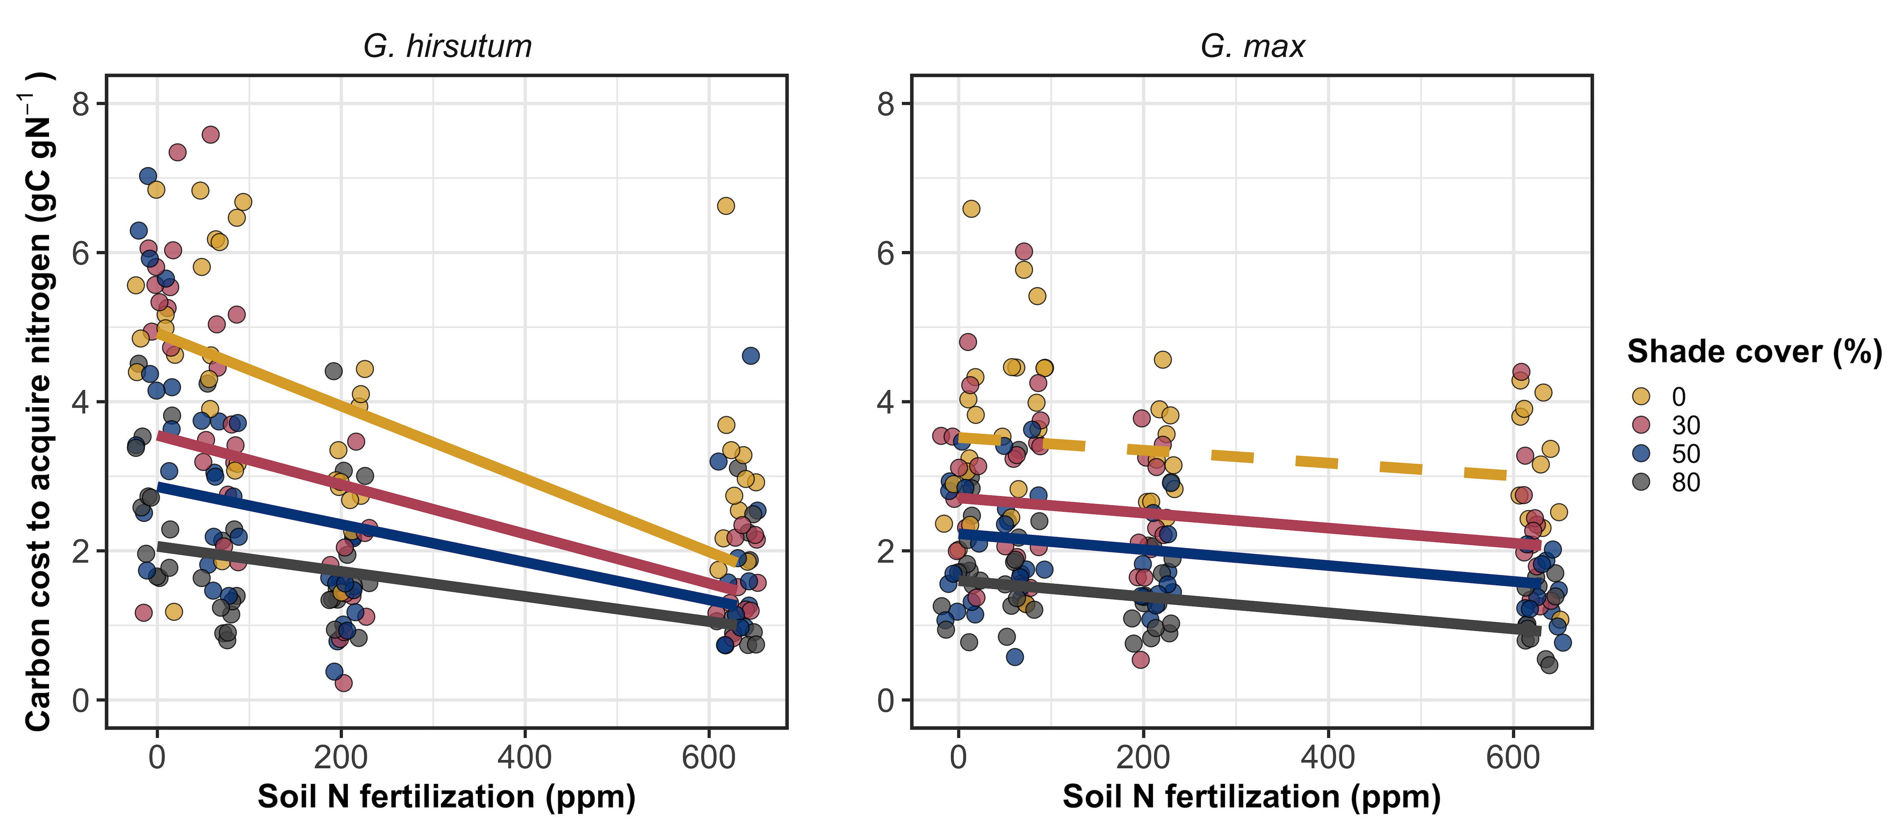
Carbon costs to acquire nitrogen decreased with increasing fertilization, but increased with increasing light availability
Perkowski et al. (2021) Journal of Experimental Botany

Slide 29
Carbon costs to acquire nitrogen decreased with increasing fertilization, but increased with increasing light availability
Perkowski et al. (2021) Journal of Experimental Botany

Slide 30
Carbon costs to acquire nitrogen decreased with increasing fertilization, but increased with increasing light availability
G. max generally less responsive to soil nitrogen availability
Perkowski et al. (2021) Journal of Experimental Botany

Slide 31
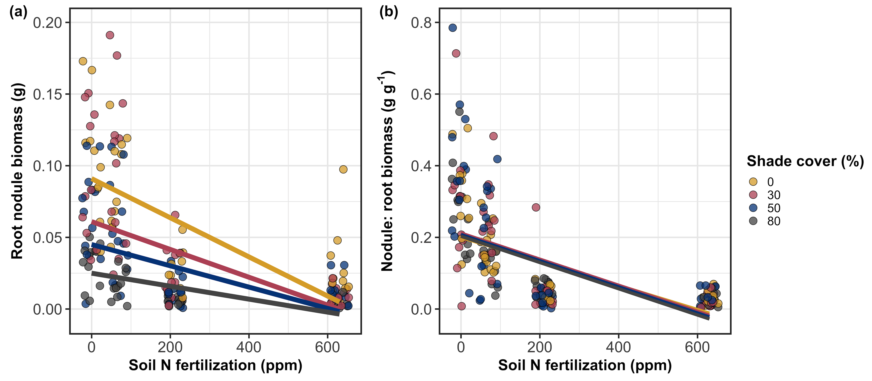
Reduced response of G. max to soil nitrogen may be due to reduced investment in root nodules
Perkowski et al. (2021) Journal of Experimental Botany

Slide 32
Experiment #2: Nitrogen-by-pH field manipulation experiment
Vignette 2
Perkowski et al. in review

Slide 33
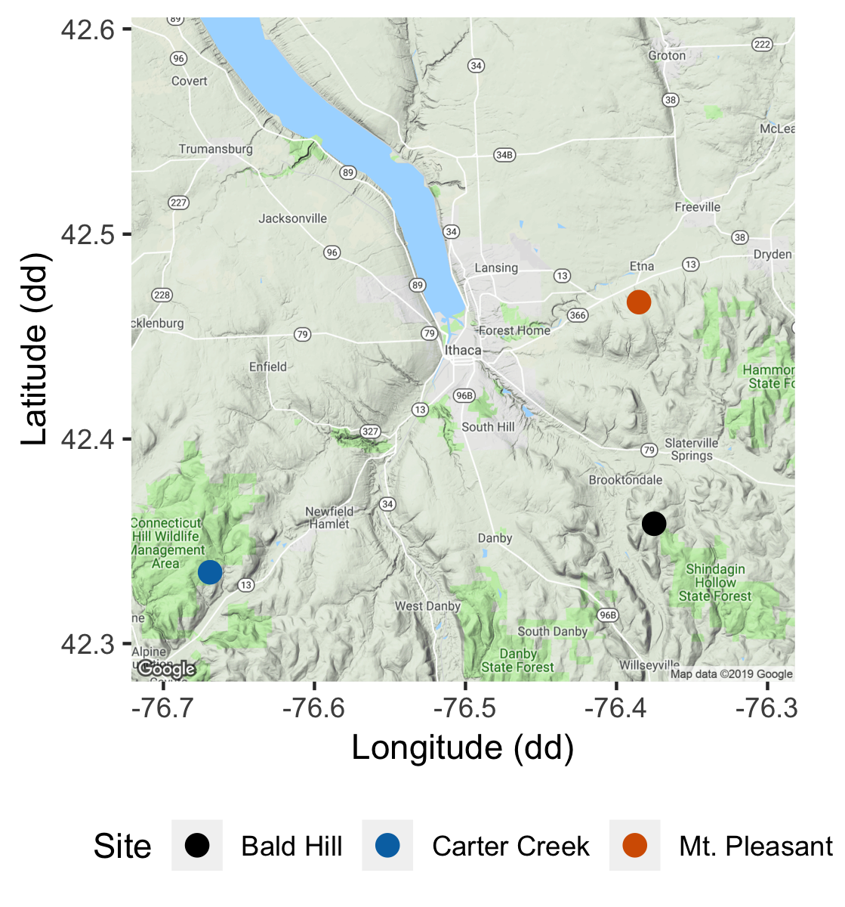
Experiment setup
Vignette 2
Soil fertilization treatments
Sites
0 kg ha⁻¹ yr⁻¹ N; 0 kg ha⁻¹ yr⁻¹ S
Bald Hill
0 kg ha⁻¹ yr⁻¹ N;
57 kg ha⁻¹ yr⁻¹ S
Mount Pleasant
50 kg ha⁻¹ yr⁻¹ N;
0 kg ha⁻¹ yr⁻¹ S
Carter Creek
50 kg ha⁻¹ yr⁻¹ N; 57 kg ha⁻¹ yr⁻¹ S
Perkowski et al. in review

Slide 34


Soil nitrogen availability
Vignette 2
RB
RB
RB
RB
RB
Ion exchange resin bag (collects anions/cations over time)
Soil N availability = sum of [NH₄-N] and [NO₃-N] averaged across all resin bags in plot
Perkowski et al. in review

Slide 35
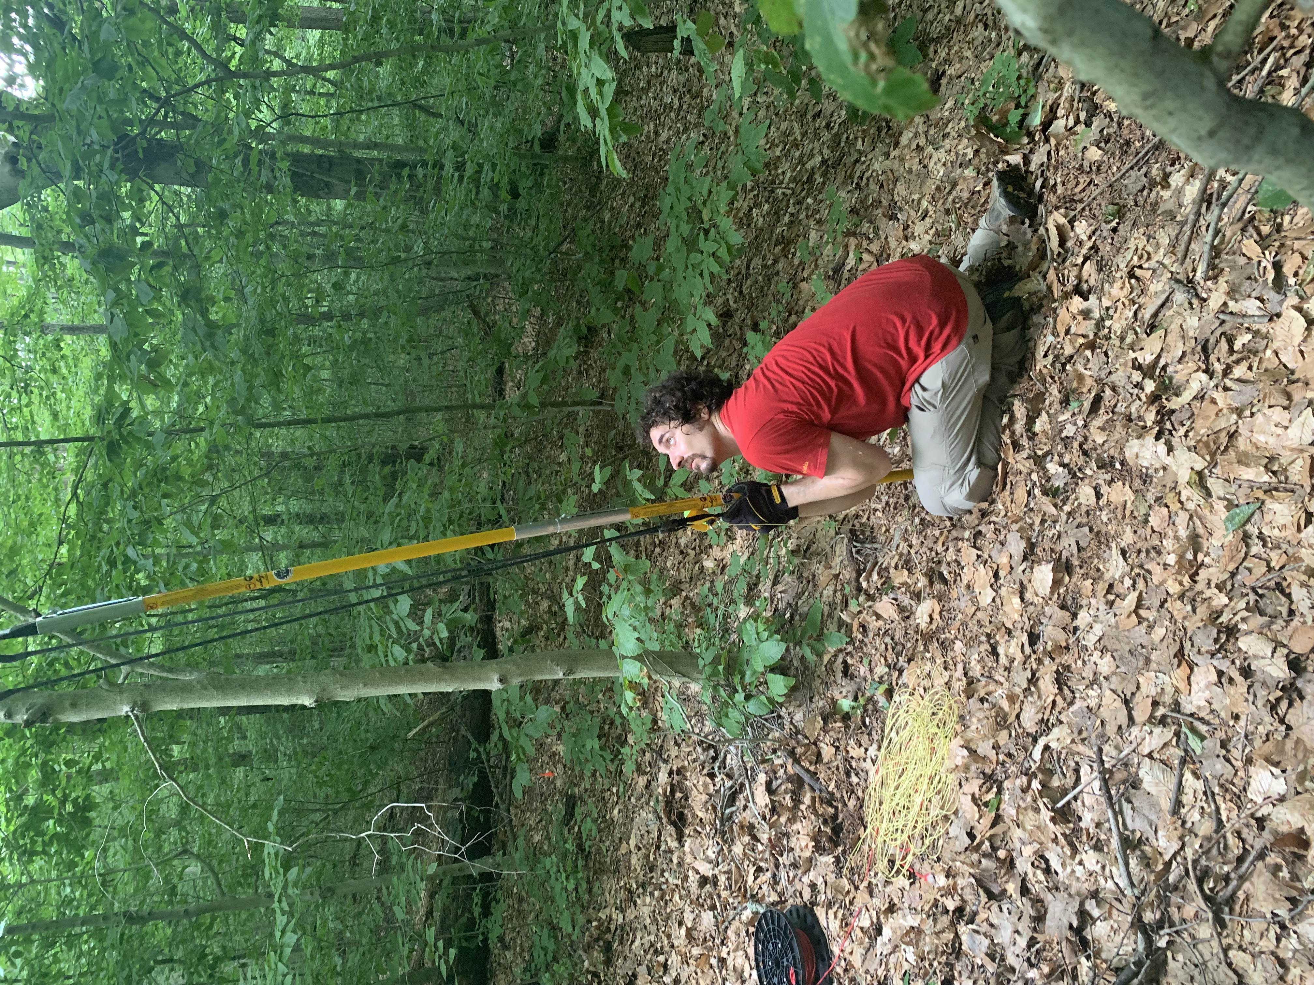
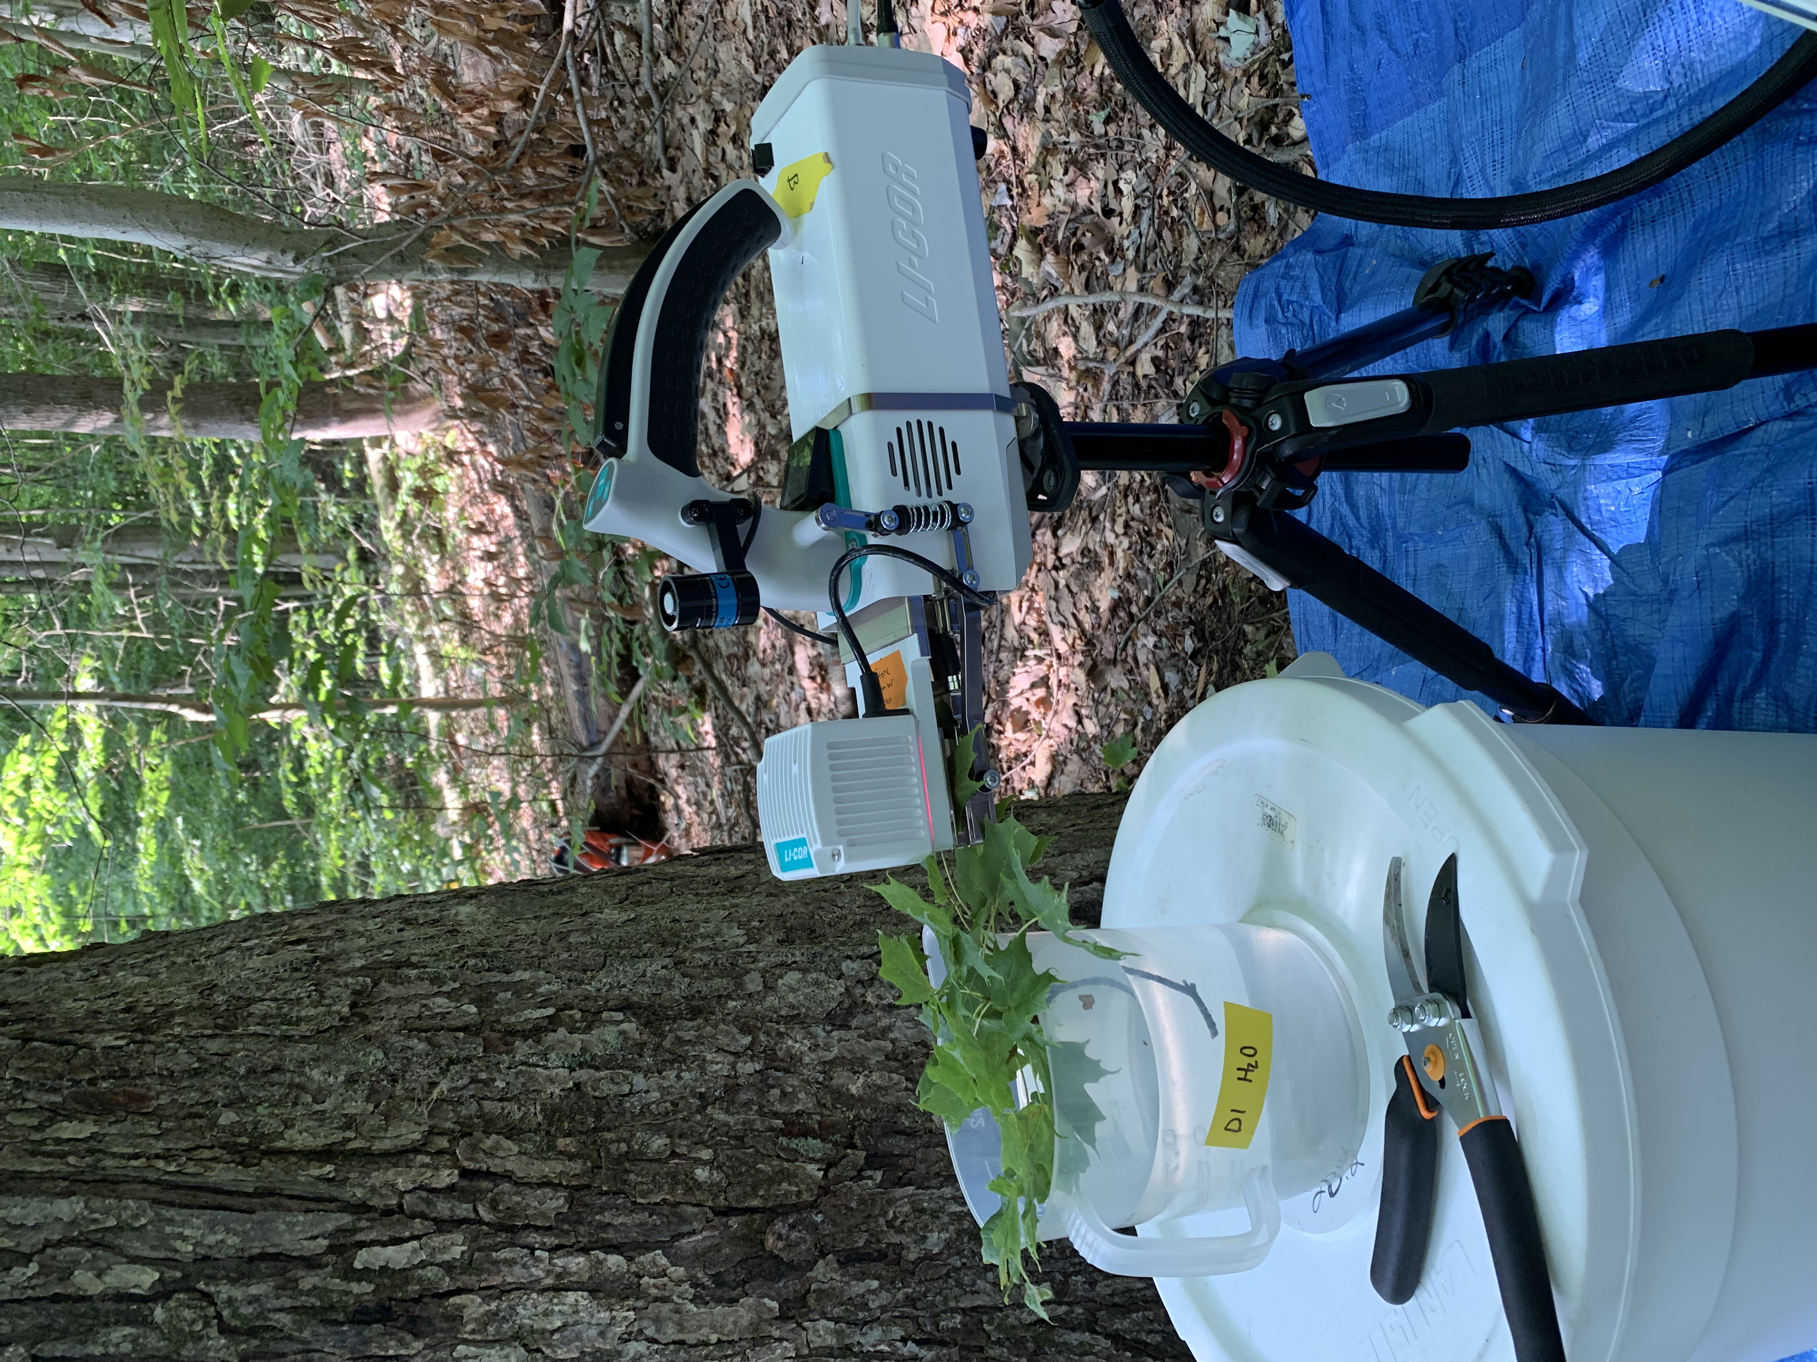
Top canopy leaf measurements
Vignette 2
Leaf nitrogen content; leaf δ¹³C
Net photosynthesis and biochemical process rates (A_{net}, V_{cmax}, J_{max})
PNUE; leaf C_{i}:C_{a}; leaf nitrogen per unit leaf C_{i}:C_{a}; V_{cmax} per unit leaf C_{i}:C_{a}
Perkowski et al. in review
Notes:
We measured both leaf and whole plant traits for 6-10 individuals in each plot at each site
We extracted net photosynthesis rate at 400 ppm CO2 and estimated Rubisco carboxylation and RuBP regeneration rates using equations from Farquhar et al. (1980).
We also quantified leaf nitrogen per unit leaf area as leaf nitrogen content divided by specific leaf area.
We then calculated photosynthetic nitrogen use efficiency using leaf nitrogen per leaf area and net photosynthesis
Finally, we measured water-use efficiency using photosynthetic and stomatal conductance data extracted from each carbon dioxide response curve
At the whole plant level, we measured the change in basal area between 2011 and 2019 to get an estimate of woody tissue production and estimated relative growth rate between the same years using allometrically-scaled biomass data

Slide 36
Experiment #3: Drivers of leaf nitrogen content across environmental gradients
Vignette 1
Vignette 2

Slide 37
Hypotheses
Vignette 1
Vignette 2
SM₉₀
N_{fixer}
VPD₄
N_{mass}
β
C_{i}:C_{a}
Ν_{area}
Soil N
C₃/C₄
M_{area}

Slide 38
The cost of acquiring and using nutrients (β) will be modified by soil resources and species identity
Vignette 1
Vignette 2
SM₉₀
N_{fixer}
VPD₄
N_{mass}
β
C_{i}:C_{a}
Ν_{area}
Soil N
C₃/C₄
M_{area}

Slide 39
Leaf C_{i}:C_{a} will be modified by costs of resource use and aboveground climate
Vignette 1
Vignette 2
SM₉₀
N_{fixer}
VPD₄
N_{mass}
β
C_{i}:C_{a}
Ν_{area}
Soil N
C₃/C₄
M_{area}

Slide 40
Leaf nitrogen content will be negatively related to leaf C_{i}:C_{a}
Vignette 1
Vignette 2
SM₉₀
N_{fixer}
VPD₄
N_{mass}
β
C_{i}:C_{a}
Ν_{area}
Soil N
C₃/C₄
M_{area}

Slide 41
Soil N may directly increase N_{area} due to increasing N_{mass}…
Vignette 1
Vignette 2
SM₉₀
N_{fixer}
VPD₄
N_{mass}
β
C_{i}:C_{a}
Ν_{area}
Soil N
C₃/C₄
M_{area}

Slide 42
… or may indirectly increase N_{area} due to reductions in the cost of acquiring nitrogen
Vignette 1
Vignette 2
SM₉₀
N_{fixer}
VPD₄
N_{mass}
β
C_{i}:C_{a}
Ν_{area}
Soil N
C₃/C₄
M_{area}

Slide 43
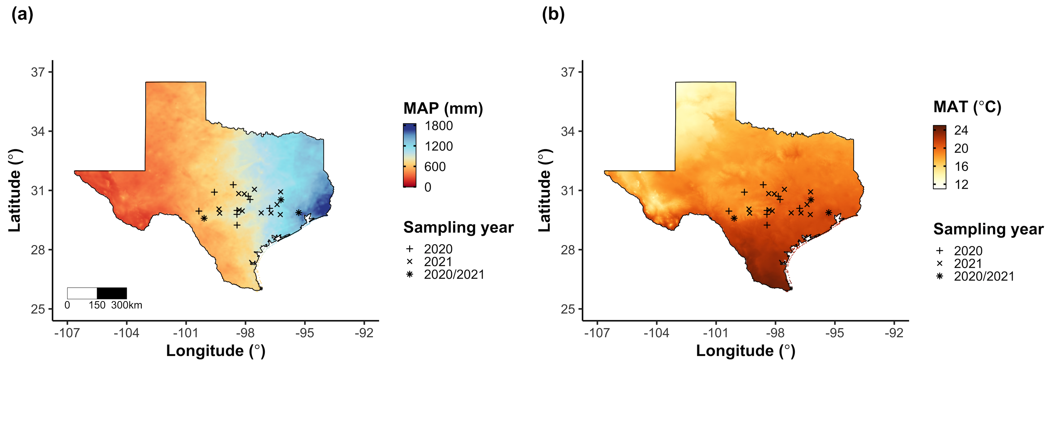
Field gradient experiment
Vignette 1
Vignette 2
24 sites
12 visited in 2020
15 visited in 2021 (3 from 2020)
3 leaves of 5 most dominant species at each site
Leaf nitrogen content
Leaf C_{i}:C_{a} (δ¹³C)
Cost of acquiring nitrogen relative to water (β)
Composite soil sample
[NO₃-N]

Slide 44
Climate and edaphic characteristics
Vignette 1
Vignette 2
PRISM data product (4-km grid across coterminous US)
Daily air temperature
Daily vapor pressure deficit
Daily precipitation
Soil moisture derived from SPLASH model
As function of water holding capacity

Slide 45
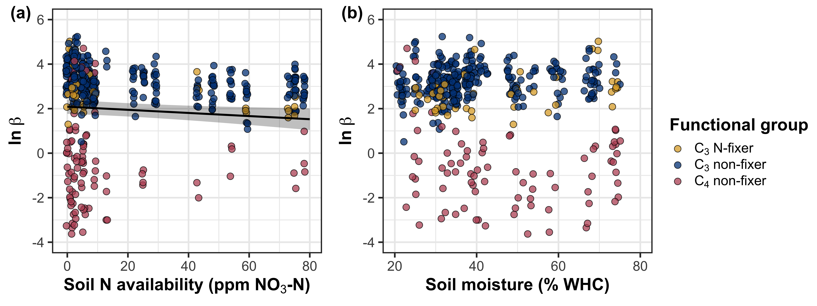
β decreases with increasing soil nitrogen, but is not modified by soil moisture
Vignette 1
Vignette 2

Slide 46
β decreases with increasing soil nitrogen, but is not modified by soil moisture
Vignette 1
Vignette 2

Slide 47
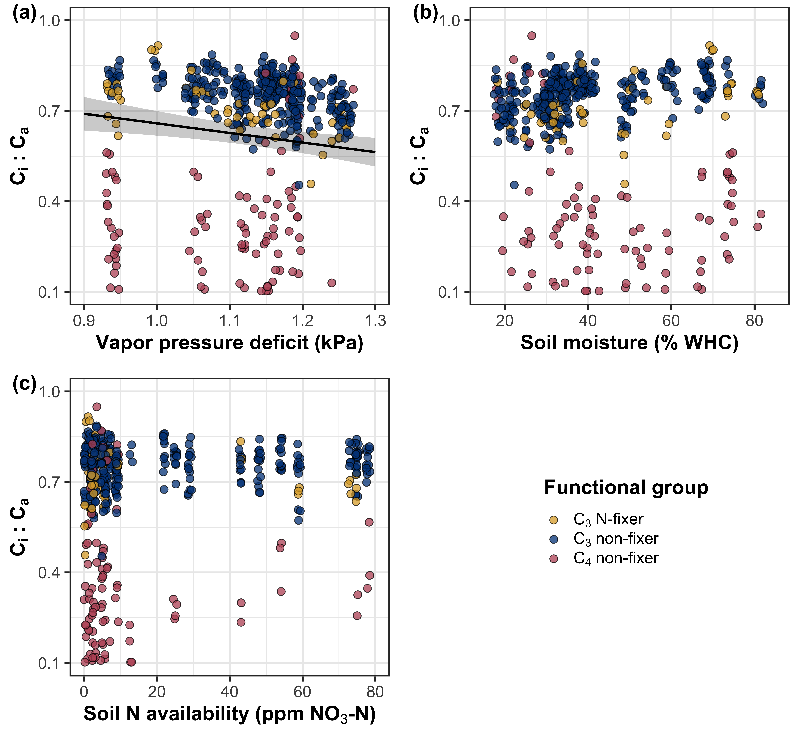
Leaf C_{i}:C_{a} decreases with increasing vapor pressure deficit
Vignette 1
Vignette 2

Slide 48
N_{area} increases with increasing soil nitrogen availability
Vignette 1
Vignette 2

Slide 49
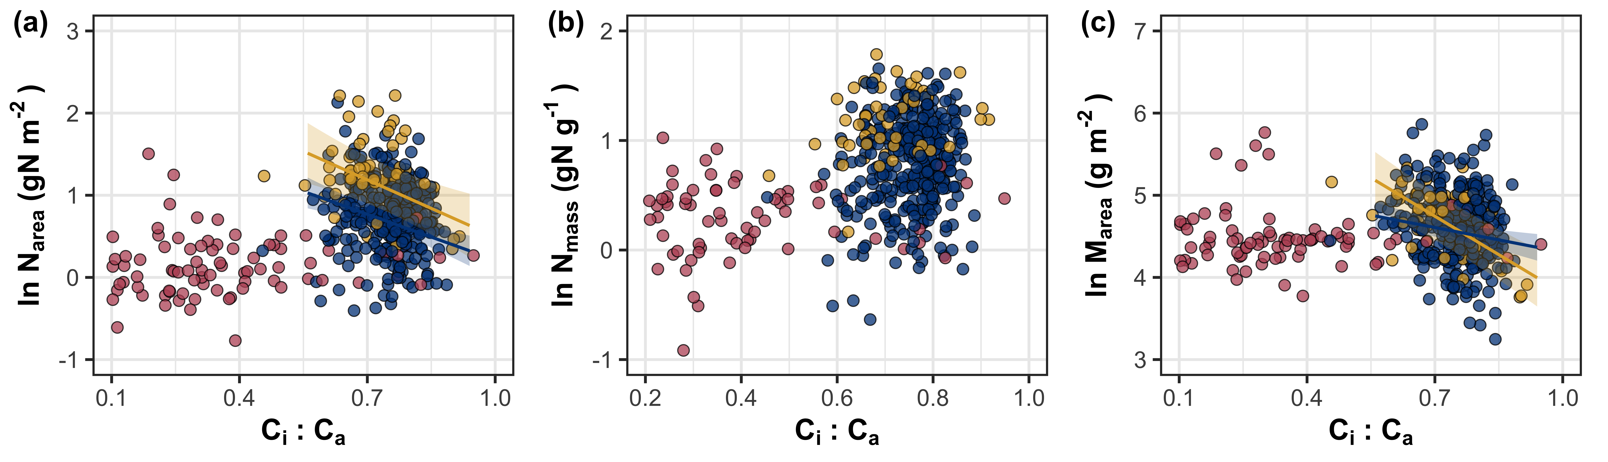
N_{area} is negatively associated with leaf C_{i}:C_{a}
Vignette 1
Vignette 2

Slide 50
Putting it all together through a piecewise structural equation model
Vignette 1
Vignette 2
SM₉₀
N_{fixer}
VPD₄
N_{mass}
β
C_{i}:C_{a}
Ν_{area}
Soil N
C₃/C₄
M_{area}

Slide 51
Vignette 1
Vignette 2
SM₉₀
N_{fixer}
VPD₄
N_{mass}
β
C_{i}:C_{a}
Ν_{area}
Soil N
C₃/C₄
M_{area}

Slide 52
β is negatively associated with increasing soil nitrogen, and generally lower in C₄ species
Vignette 1
Vignette 2
SM₉₀
N_{fixer}
VPD₄
N_{mass}
β
C_{i}:C_{a}
Ν_{area}
Soil N
C₃/C₄
M_{area}

Slide 53
Soil moisture was positively associated with soil nitrogen availability
Vignette 1
Vignette 2
SM₉₀
N_{fixer}
VPD₄
N_{mass}
β
C_{i}:C_{a}
Ν_{area}
Soil N
C₃/C₄
M_{area}

Slide 54
Vignette 1
Vignette 2
SM₉₀
N_{fixer}
VPD₄
N_{mass}
β
C_{i}:C_{a}
Ν_{area}
Soil N
C₃/C₄
M_{area}

Slide 55
Leaf C_{i}:C_{a} is negatively related to increasing vapor pressure deficit and positively related to β
Vignette 1
Vignette 2
SM₉₀
N_{fixer}
VPD₄
N_{mass}
β
C_{i}:C_{a}
Ν_{area}
Soil N
C₃/C₄
M_{area}

Slide 56
Vignette 1
Vignette 2
SM₉₀
N_{fixer}
VPD₄
N_{mass}
β
C_{i}:C_{a}
Ν_{area}
Soil N
C₃/C₄
M_{area}

Slide 57
M_{area} is negatively related to leaf C_{i}:C_{a}, while N_{mass} is positively related to leaf C_{i}:C_{a}
Vignette 1
Vignette 2
SM₉₀
N_{fixer}
VPD₄
N_{mass}
β
C_{i}:C_{a}
Ν_{area}
Soil N
C₃/C₄
M_{area}

Slide 58
Vignette 1
Vignette 2
SM₉₀
N_{fixer}
VPD₄
N_{mass}
β
C_{i}:C_{a}
Ν_{area}
Soil N
C₃/C₄
M_{area}

Slide 59
Increasing soil nitrogen availability directly increases N_{mass} and decreases M_{area}
Vignette 1
Vignette 2
SM₉₀
N_{fixer}
VPD₄
N_{mass}
β
C_{i}:C_{a}
Ν_{area}
Soil N
C₃/C₄
M_{area}

Slide 60
Vignette 1
Vignette 2
SM₉₀
N_{fixer}
VPD₄
N_{mass}
β
C_{i}:C_{a}
Ν_{area}
Soil N
C₃/C₄
M_{area}

Slide 61
N-fixation ability directly increases N_{mass}
Vignette 1
Vignette 2
SM₉₀
N_{fixer}
VPD₄
N_{mass}
β
C_{i}:C_{a}
Ν_{area}
Soil N
C₃/C₄
M_{area}

Slide 62
Vignette 1
Vignette 2
SM₉₀
N_{fixer}
VPD₄
N_{mass}
β
C_{i}:C_{a}
Ν_{area}
Soil N
C₃/C₄
M_{area}

Slide 63
Soil moisture was positively associated with soil nitrogen availability
Vignette 1
Vignette 2
SM₉₀
N_{fixer}
VPD₄
N_{mass}
β
C_{i}:C_{a}
Ν_{area}
Soil N
C₃/C₄
M_{area}

Slide 64
Vignette 1
Vignette 2
55%
SM₉₀
N_{fixer}
VPD₄
N_{mass}
38%
82%
89%
β
C_{i}:C_{a}
Ν_{area}
35%
56%
Soil N
C₃/C₄
M_{area}

Slide 65
Soil N directly increased N_{area} due to a larger stimulation in N_{mass} than decline in M_{area}
Vignette 1
Vignette 2
55%
SM₉₀
N_{fixer}
VPD₄
N_{mass}
38%
82%
89%
β
C_{i}:C_{a}
Ν_{area}
35%
56%
Soil N
C₃/C₄
M_{area}

Slide 66
But, soil nitrogen availability also indirectly increased N_{area} due to reductions in the cost of acquiring nitrogen
Vignette 1
Vignette 2
55%
SM₉₀
N_{fixer}
VPD₄
N_{mass}
38%
82%
89%
β
C_{i}:C_{a}
Ν_{area}
35%
56%
Soil N
C₃/C₄
M_{area}

Slide 67
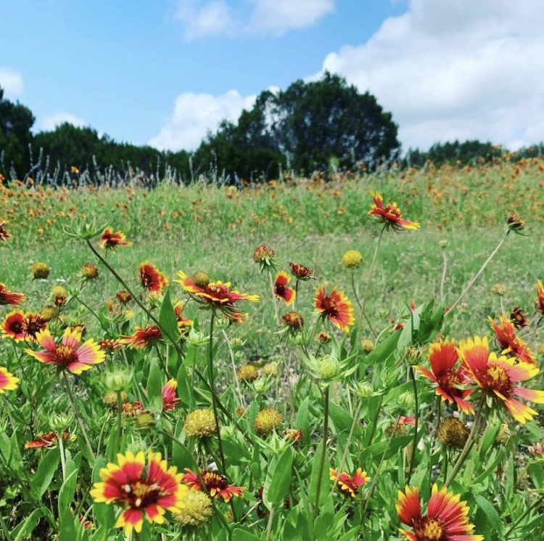
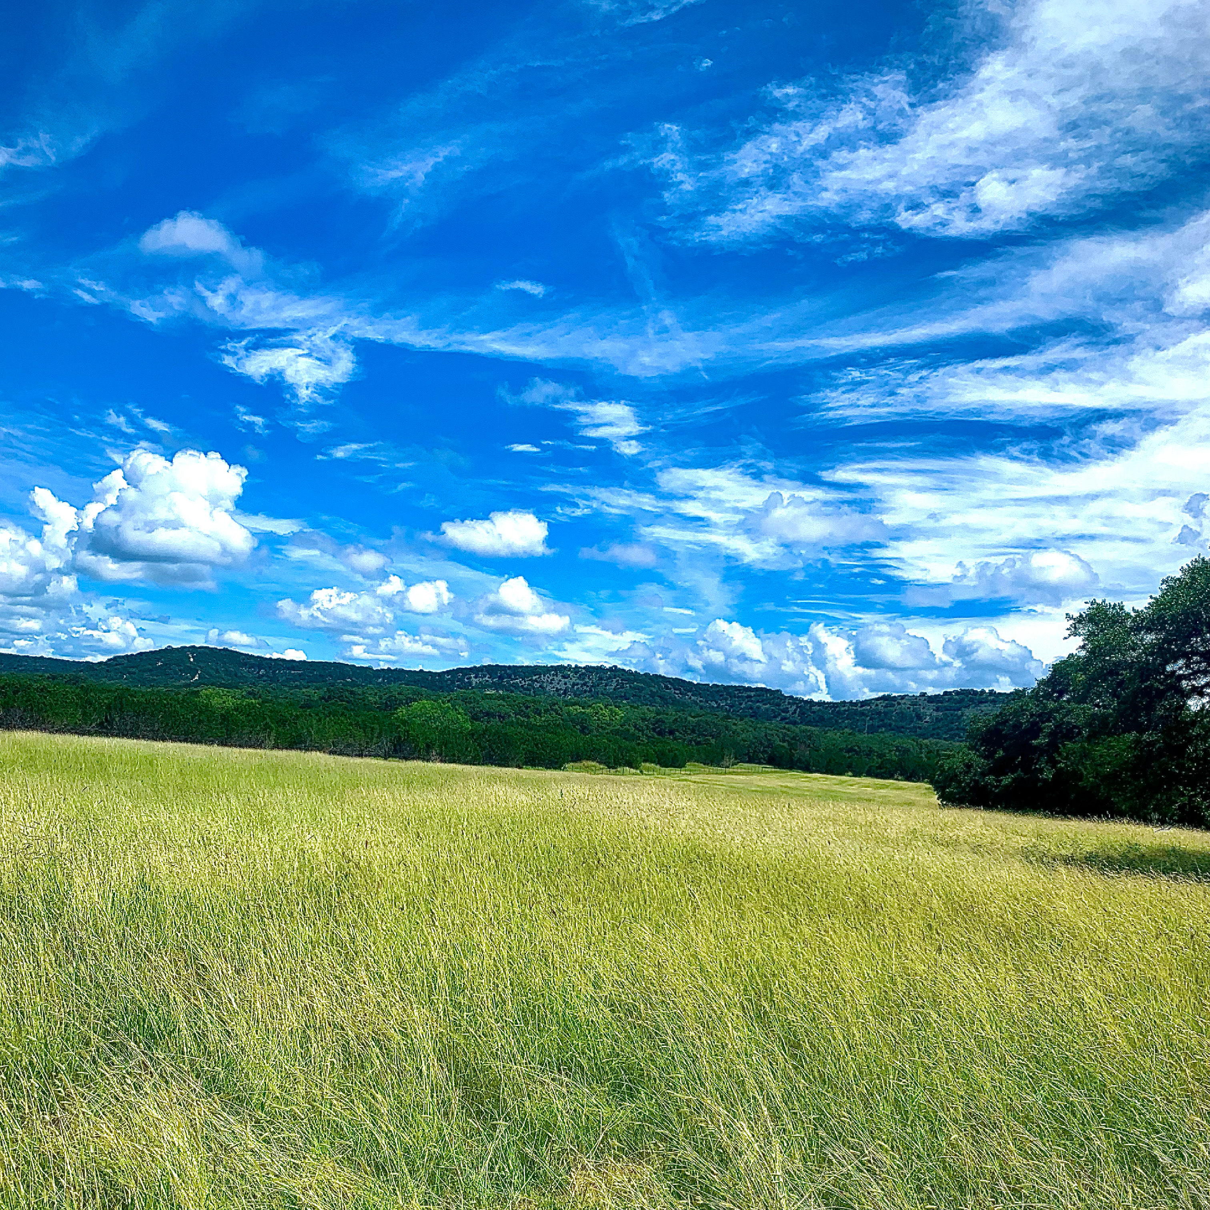
Conclusions
Vignette 1
Vignette 2

Slide 68
Experiment #4: CO₂-by-nitrogen-by-inoculation growth chamber manipulation experiment
Vignette 1
Vignette 2
Vignette 3

Slide 69
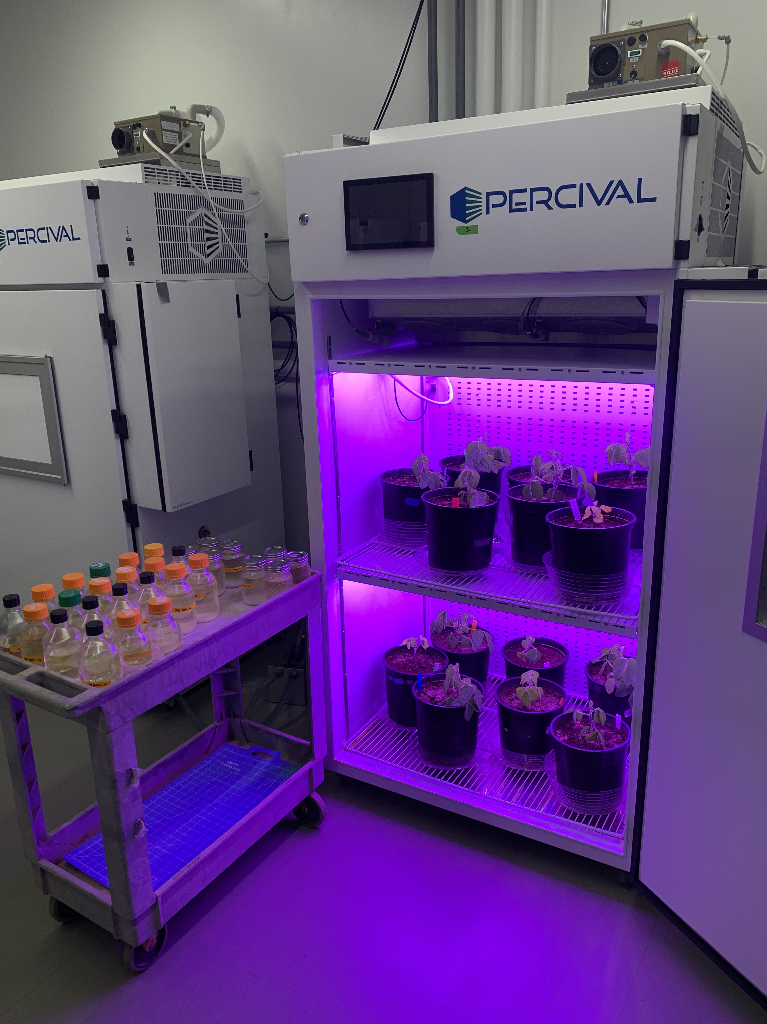
Experiment setup
Vignette 1
Vignette 2
Vignette 3
Acquisition strategy
Soil N treatments
0 ppm N
+ BNF
35 ppm N
- BNF
70 ppm N
105 ppm N
CO₂ treatments
140 ppm N
210 ppm N
+ BNF
280 ppm N
- BNF
350 ppm N
630 ppm N

Slide 70
Vignette 1: How do costs of nitrogen acquisition vary across environments?

Slide 71
Vignette 2: To what extent do edaphic and climatic factors modify nitrogen-water use tradeoffs and leaf nitrogen-photosynthesis relationships?

Slide 72
Vignette 3: How does soil nitrogen availability modify plant acclimation responses to elevated CO₂?

Slide 73
Future Plans

Slide 74



Acknowledgements
Committee
CHAIR: NICK SMITH
AIMÉE CLASSEN

